Slide 1
[For IMAP users]
How to copy emails
from Enterprise Mail
into your local folder
Version 1.0

Slide 2
Revision History
Version | Date | Revision History
 |  | Section | Revised Parts
Version 1.0 |  |  | Newly created

Slide 3
Table of Contents
1 | Introduction
2 | How to copy emails into your local folder [Microsoft Outlook]
3 | How to copy emails into your local folder [Thunderbird]

Slide 4
1. Introduction
This document is the manual which describes how to copy emails from Enterprise Mail to your local folder for users utilize email client software, such as Microsoft Outlook or Thunderbird and connect Enterprise Mail with IMAP. Please note that the content of this document might be different from your environment due to the difference of the version of your software.

Slide 5
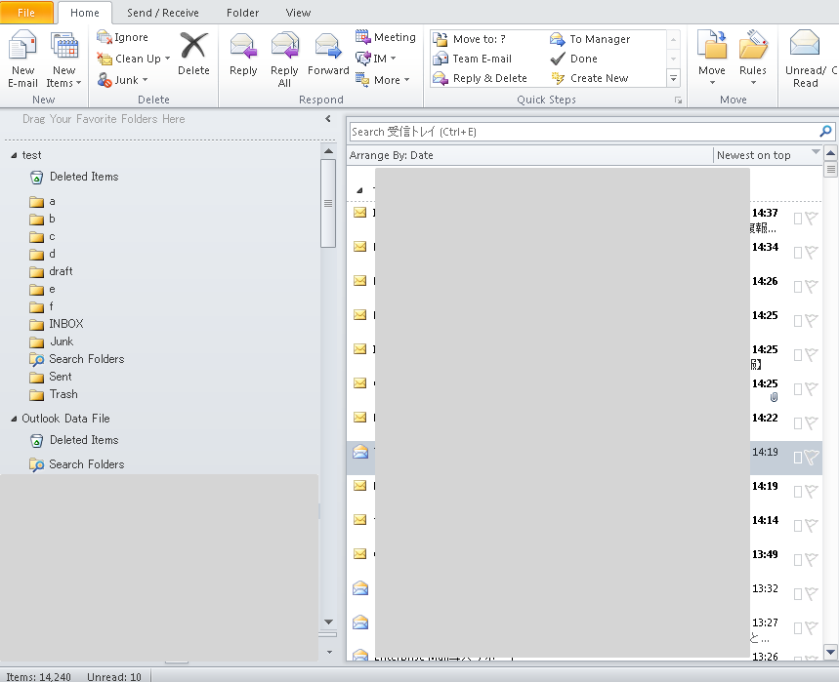
2. How to copy emails into your local folder
[Microsoft Outlook]
Please note that the snapshots in this document are from Microsoft Outlook 2010. You can execute the same procedures even if you use Microsoft Outlook 2013 or 2016.
You have two types of areas which contains emails
1 emails synchronize with IMAP server of Enterprise Mail
2 emails in your local folder
You can view emails even if your Enterprise Mail account is deleted by copying emails from IMAP server to your local folder.
Emails synchronize with IMAP server of Enterprise Mail
Local Storage (PST file)

Slide 6
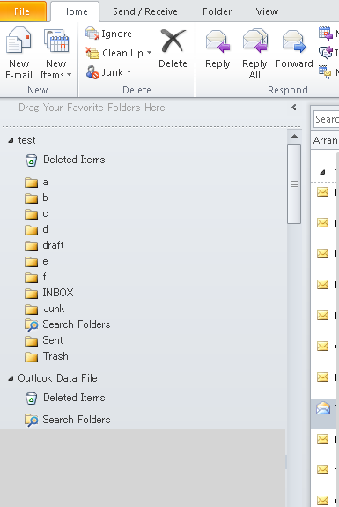
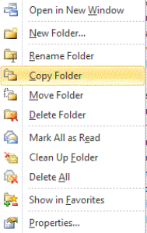
2. How to copy emails into your local folder
[Microsoft Outlook]
1. Right click on the folder which contains emails you want to copy into your local folder.
2. Select [Copy Folder] and specify the destination folder on your local storage.
Operation steps [Fig. 01]
1
2
[Fig. 01/Step 1 to 2]
2
[Fig. 02/Step 2]

Slide 7
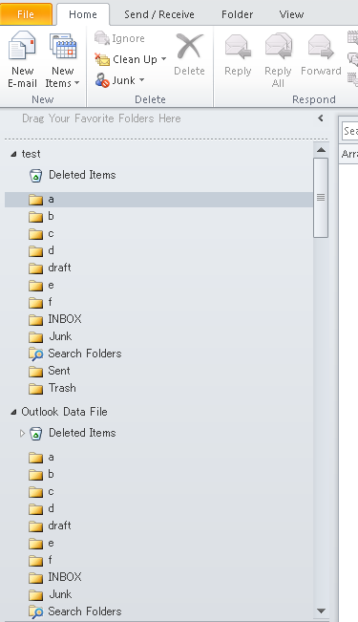
2. How to copy emails into your local folder
[Microsoft Outlook]
1. Check if emails and folders have been correctly copied into your local folder.
Operation steps [Fig. 03]
1
[Fig. 03/Steps 1]

Slide 8
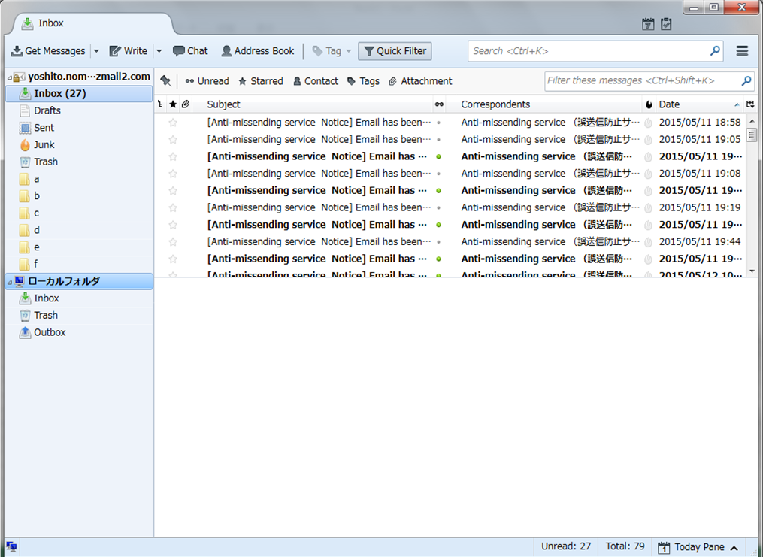
3. How to copy emails into your local folder
[Thunderbird]
Please note that the snapshots in this document are from Thunderbird 52.5.
You have two types of areas which contains emails
1 emails synchronize with IMAP server of Enterprise Mail
2 emails in your local folder
You can view emails even if your Enterprise Mail account is deleted by copying emails from IMAP server to your local folder.
Emails synchronize with IMAP server of Enterprise Mail
Local Folder

Slide 9
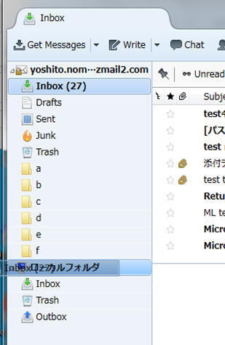
3. How to copy emails into your local folder
[Thunderbird]
1. Click on the folder which contains emails you want to copy into your local folder.
2. Drag and drop the folder on your local folder.
Operation steps [Fig. 01]
1
2
[Fig. 01/Step 1 to 2]

Slide 10
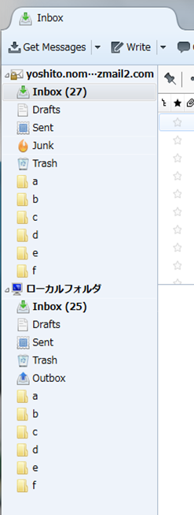
3. How to copy emails into your local folder
[Thunderbird]
1. Check if emails and folders have been correctly copied into your local folder.
Operation steps [Fig. 02]
1
[Fig. 02/Steps 1]

